Slide 1

Database Architecture

Slide 2
Topic of discussion
Two tier Architecture?
Three tier Architecture?

Slide 3
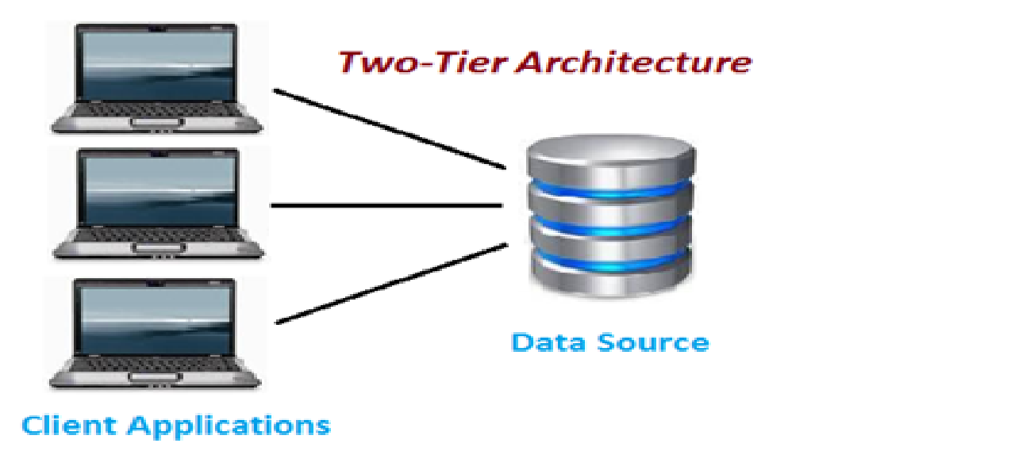
Two Tier Architecture
Two tier architecture is similar to a basic client-server model.
The application at the client end directly communicates with the database at the server side.
API’s like ODBC,JDBC are used for this interaction.

Slide 4
Two Tier Architecture
The server side is responsible for providing query processing and transaction management functionalities. On the client side, the user interfaces and application programs are run

Slide 5
Advantage of Two Tier Architecture
An advantage of this type is that maintenance and understanding is easier, compatible with existing systems. However this model gives poor performance when there are a large number of users.

Slide 6
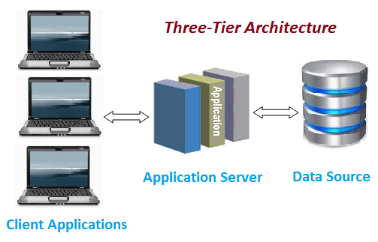
Three Tier Architecture
In this type, there is another layer between the client and the server. The client does not directly communicate with the server.
Instead, it interacts with an application server which further communicates with the database system and then the query processing and transaction management takes place.

Slide 7
Advantage of Three Tier Architecture
Enhanced scalability due to distributed deployment of application servers. Now, individual connections need not be made between client and server.
Data Integrity is maintained. Since there is a middle layer between client and server, data corruption can be avoided/removed.
Security is improved. This type of model prevents direct interaction of the client with the server thereby reducing access to unauthorized data.

Slide 8
Disadvantage of Three Tier Architecture
Increased complexity of implementation and communication. It becomes difficult for this sort of interaction to take place due to presence of middle layers.

Slide 9
Thank you

